Slide 1
Fifteen Puzzle
(Web Dev Project-3) - HTML, CSS, and JavaScript

Slide 2
TOC
Kanban Benefits
Limitations
Sprint Review DevOps Benefits
Demo
Youtube/Demo Link
Github Link
Team Members
Overview
Pages
Features
Changing Dimensions
Shuffle
Cheat
Background Selector
Obstacles

Slide 3
Team Members
Nolan Hinshaw - Programmer
Santiago Fleiderman- Designer
Christian Spencer - Tester
Jenny Dinh - Programmer
Nishant Datla - Tester

Slide 4
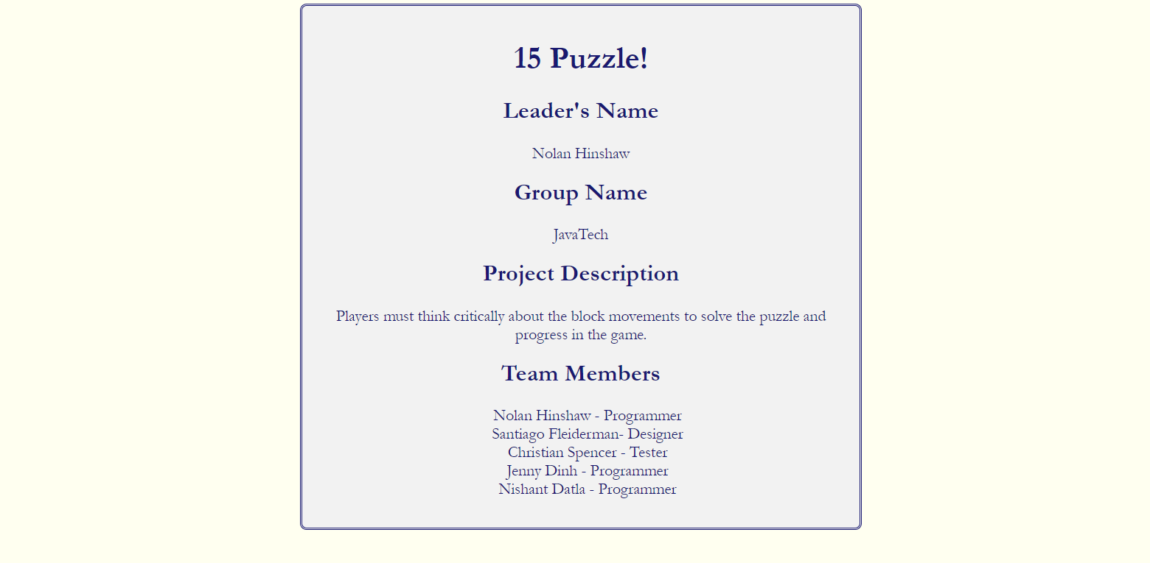

Slide 5
Overview/Objective of JavaTech’s Fifteen Puzzle
End of Game Notifications
After putting all pieces into place, the game will notify you that you have won
Multiple Backgrounds
To make the game vary, we implemented different backgrounds
Step Counter
Displays and keeps track of the number of steps you’ve taken
Different puzzle sizes
Adds variety to the game which allows users to change the dimensions of the square
Cheats/Privileges
Allow users to view what the finished puzzle should look like

Slide 6
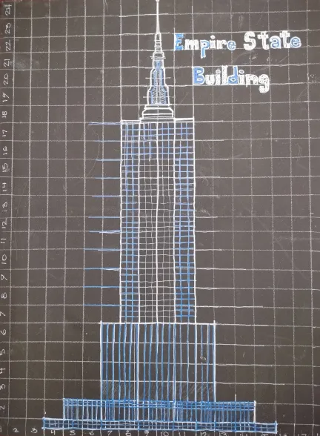
WireFrame

Slide 7
The Game

Slide 8
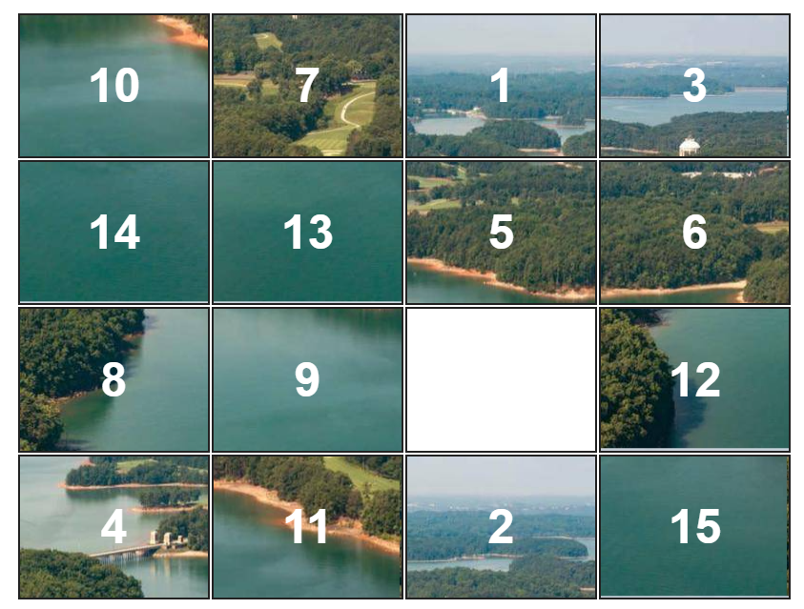

Slide 9
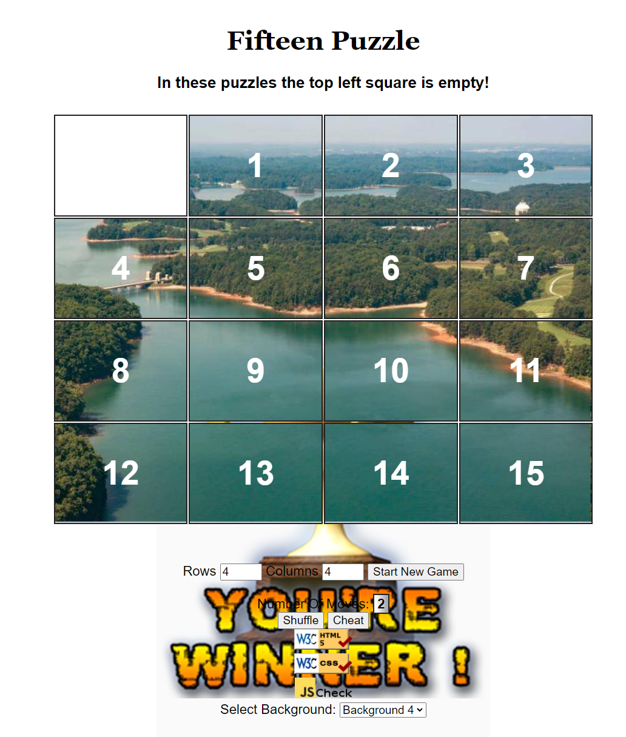
Solved Puzzle

Slide 10
Game Functionality

Slide 11
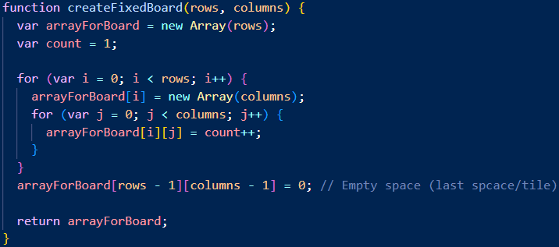
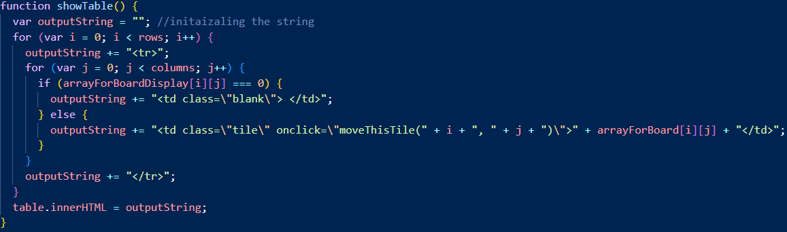
Creating the puzzle board.
createFixedboard(); is a function that creates the board and stores it in a 2D array called arrayForBoard. It then sets the last element of the array’s value to 0.
The function showTable prints the board initialized in createFixedBoard(); and sets the final tile as blank

Slide 12
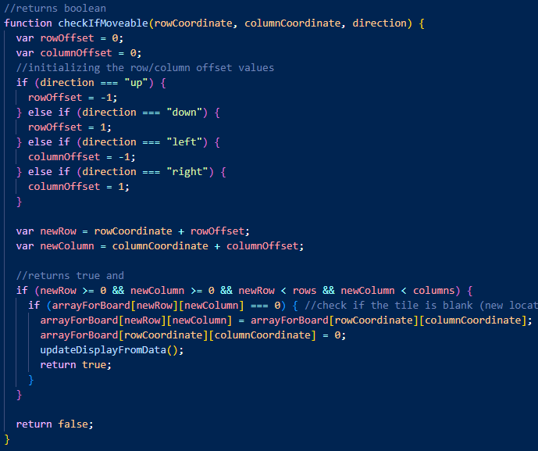
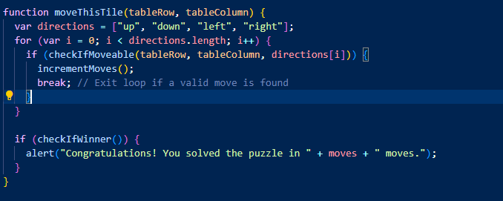
Moving tiles
The moveThisTile() function moves tiles and checks if the move wins the game. If the a move solves the puzzle it prompt’s a victory pop-up.
The checkIfMovable() function checks if an adjacent block is empty before allowing a move to happen, if there is a valid move available it moves the tile to the empty block.
Notes:
nolan

Slide 13
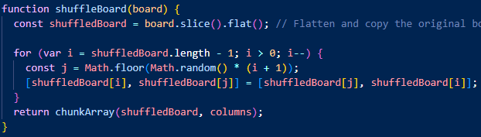
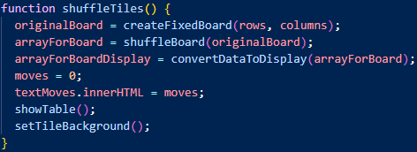
Shuffle

Slide 14
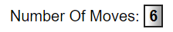
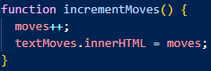
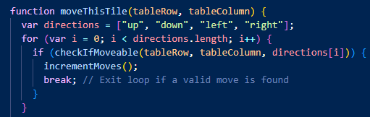
Move counter
Increments a counter each time a player makes a valid move.

Slide 15
Extra Features

Slide 16
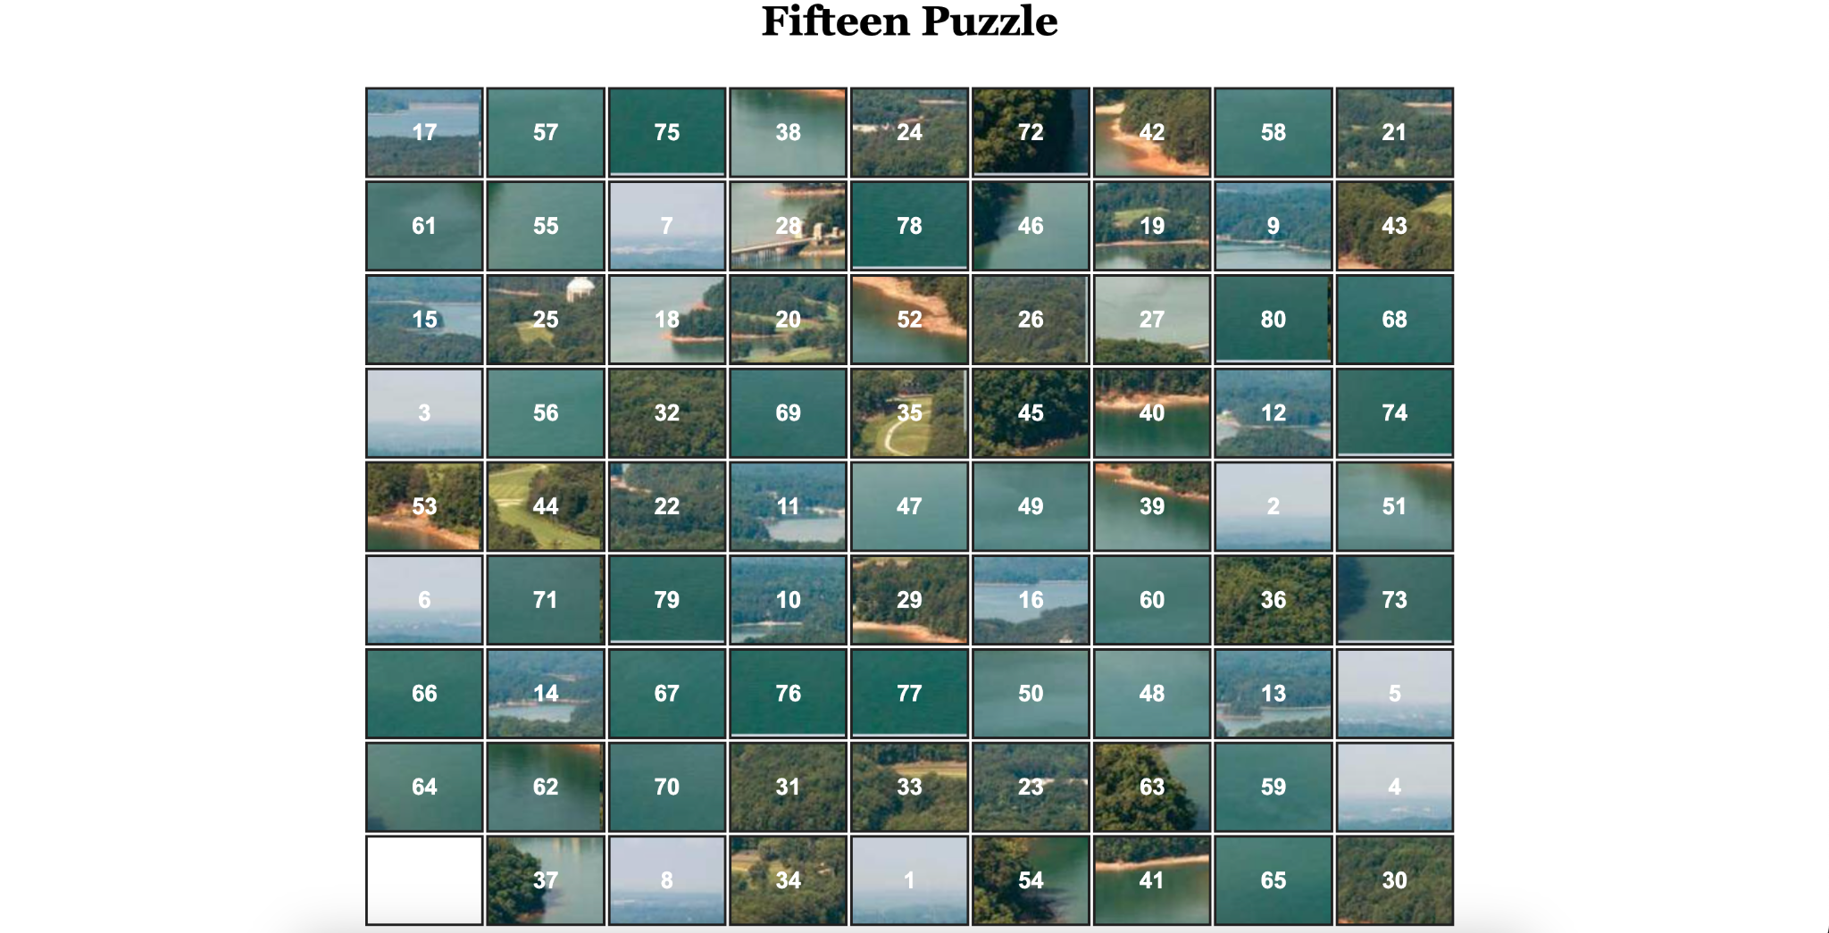
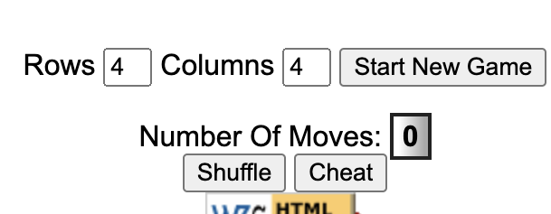
Changing Dimensions

Slide 17
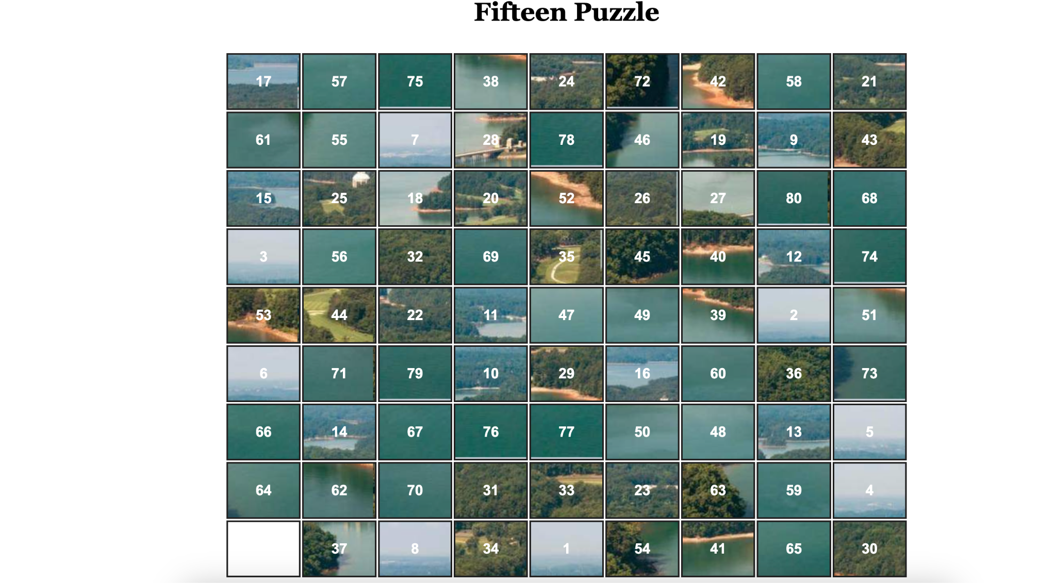
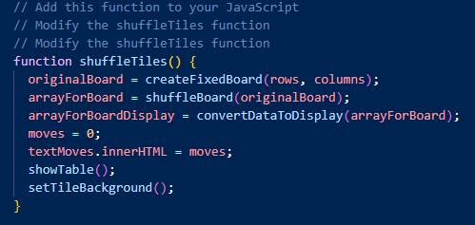
Shuffle

Slide 18
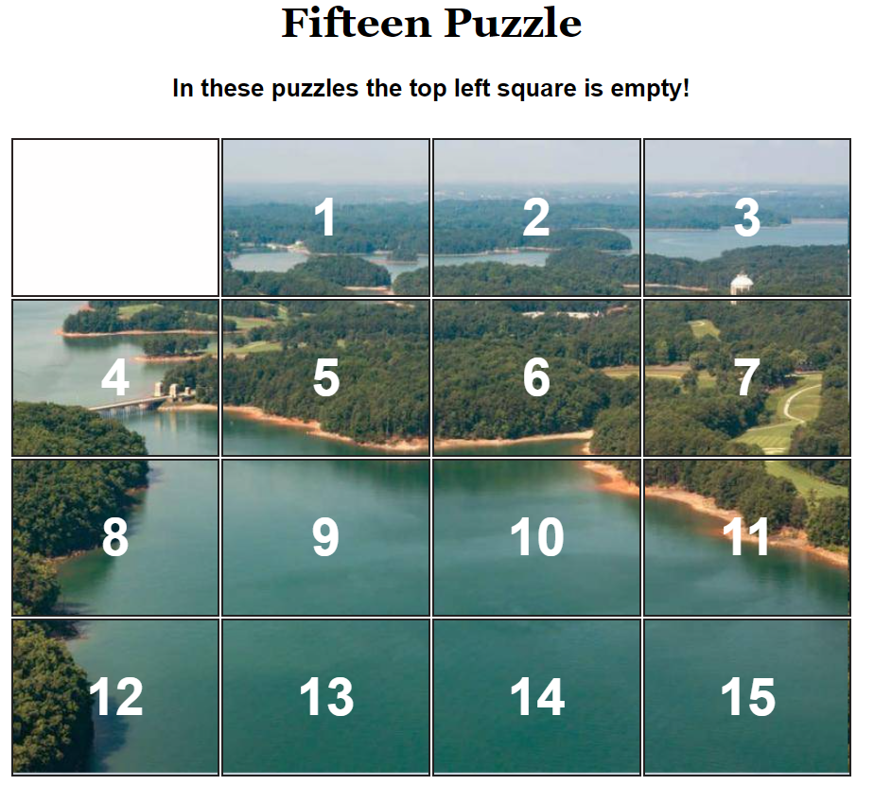
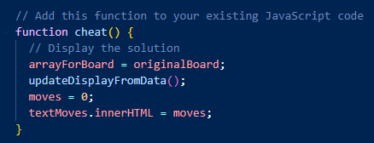
Cheat

Slide 19
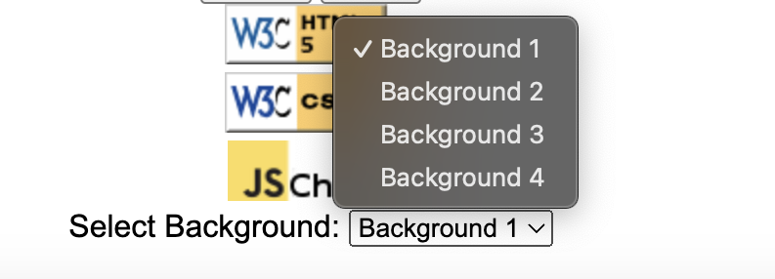
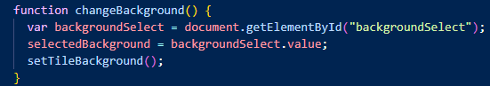
Background Selector

Slide 20
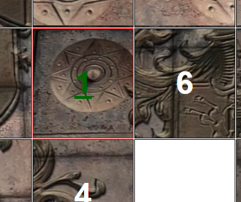
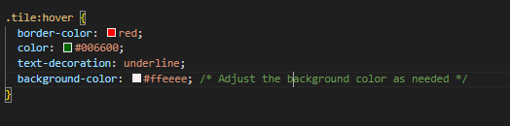
Behavior Details
Hovers over square

Slide 21
Kanban Benefits(Scrum)
1. Visual Management: Kanban uses visual boards or cards to represent tasks or work items, making it easy to see the status of work in progress. This visual representation helps teams understand workloads, identify bottlenecks, and maintain transparency.
2. Flexibility: Kanban is highly adaptable and can be implemented in various contexts, from manufacturing to project management. Teams can easily adjust and customize their Kanban boards to fit their specific needs.
3. Continuous Improvement: Kanban emphasizes the concept of continuous improvement. Teams regularly review their processes and make incremental changes to enhance efficiency and reduce waste. This iterative approach promotes a culture of ongoing improvement.
4. WIP Limitation: Kanban typically includes work-in-progress (WIP) limits, which restrict the number of tasks a team can work on simultaneously. This constraint helps prevent overloading and promotes Communication: Kanban encourages open communication within teams and across departments. Team members can see the status of tasks on the Kanban board, which promotes collaboration and keeps everyone informed.
Notes:
Santiago Perhaps?

Slide 22
Sprint Planning/Sprint Review
The Team discusses what went well during the Sprint, what problems it ran into, and how those problems were solved.
The Team demonstrates the work that it has completed and answers questions, if any, about the Increment. The entire group then discusses on what to do next. Thus, the Sprint Review provides valuable input to Sprint Planning of the subsequent Sprint.
Identify the major items that went well and potential improvements.

Slide 23
What are benefits of DevOps?
A merging of development and operations
Strong communication, collaboration, and integration between software engineers and information infrastructures
Enables rapid evolution of products or services
Reduces risk
Improves quality
Reduces costs

Slide 24
Demo

Slide 25
Obstacles
Aligning tiles
rowOffset/columnOffset
Shuffling tiles
Cheat algorithm
Scaling board with background image
Logic behind rows and columns
Empty tile
Behavior and logic when handling the empty tile
Multiple Backgrounds

Slide 26
Youtube:
https://www.youtube.com/watch?v=yw4EqNmWbPA
https://www.youtube.com/watch?v=fZ05auHKe3I
Demo: https://codd.cs.gsu.edu/~ndatla1/pr3/index.html

Slide 27
Fifteen Puzzle Github: https://github.com/diocletian53/CSC-4370-Team-Project-3

Slide 28
Fin.

